Slide 1
New UF Fertilization Certificate Program and Managing Soil pH in Blueberry Nutrition
Dr. Tom Obreza

Slide 3
Fertilizer Science and Technology Graduate Certificate
Official Start – Spring term 2023
Requirements for Completion:
A total of four courses, 3 core courses (9 credits), 1 elective course (3 credits)
The courses for the certificate were existing with one recently approved
Ongoing discussions with sponsors of field visits to observe fertilizer formulation facilities, field operations, and research sites
Soliciting sponsors for Scholarship/internship opportunities

Slide 4
Required Courses
SWS 5115 – Environmental nutrient management - 3 credits (on-line) Springs even years
SWS 6136 – Soil Nutrient Diagnostics for Ag Production - 3 credits (on-line) every Summer
SWS 6117 - Fertilizer Technology, Production and Use 3 credits (online) Fall odd years – approved in 2022 – (on-line) first class Fall 2023 – Fall even years

Slide 5
Elective Courses (Choose One)
SWS 5234 Environmental soil, water, and land use - 3 Credits (on-line) every Fall
SWS 6134 Soil quality -3 Credits(on-line) Fall even years
AGR 6422C Environmental crop nutrition - 3 Credits (on-line) every Fall
HOS 6412 Nutrition of horticultural crops - 3 Credits (on-line) every Spring

Slide 6
Target Audience Future Events
Graduate Students
Growers
Ag Consultants
Environmentalists
State Regulators
Addition of graduate concentrations
on fertilizer and irrigation management
Field trips to be added with sponsor
support
Mining operations
Fertilizer formulation facilities
Research plots to view 4R related results
Online and in-person fertilizer related
seminar series

Slide 7
Best pH for Blueberry Production
Recommendations below can be found in HS 1356 Nutrition and Fertilization Practices for Southern Highbush Blueberry in Florida.
Blueberry plants evolved under acidic, low-nutrient conditions.
Both Rabbiteye and Southern Highbush (SHB) thrive on acidic soils(the recommended pH range for blueberries is 4.5–5.5).
Most Florida soils are low in organic matter, and generally have a pH higher than that required for good blueberry growth, health, and the uptake of certain nutrients.
SHB are typically planted either directly into raised beds of milled pine bark or into soil beds that have been amended with pine bark providing organic matter and lower pH.
Acid injection into drip irrigation systems, or soil applied sulfur, is often needed to maintain proper soil pH.

Slide 8
What is Soil pH?
A measure of how acidic or alkaline a soil is.
The pH scale ranges from 0 to 14, where a pH of 7 is neutral.
The lower the pH value, the more acidic a substance is, while the higher the pH value is on the scale, the more alkaline (basic) it is.
pH is logarithmic
If you reduce the pH of your soil by 1 point, your soil becomes 10x more acidic.
If you reduce the pH of your soil by 2 points, your soil becomes 100x more acidic.
etc

Slide 9
Dissociation of water
H₂O ⇆ H⁺ + OH⁻ H₂O + H⁺ ⇆ H₃O⁺
Water is both a weak acid and weak based since both H+ and OH- are produced.
Pure water has a pH of 7 [H⁺] X [OH⁻] = [10⁻⁷ M] X [10⁻⁷ M]
Water in equilibrium with atmospheric CO₂ has a pH of 5.5 – 5.7
H₂O + CO₂ ⇆ H⁺ + HCO₃⁻
Concentration of H+ is expressed as pH
pH = log $\frac{1}{(H+)}$ = -log(H⁺) Thus if H⁺ = 10⁻⁵, pH = 5

Slide 10
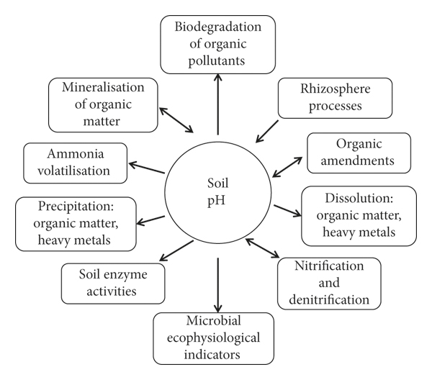
Soil chemical and biological functions are influenced by pH
Plant nutrient availability depends on nutrient concentration in solution
Solubility of nutrients are dependent on both soil buffering capacity and cation exchange capacity
pH determines rate of ammonia volatilization

Slide 11
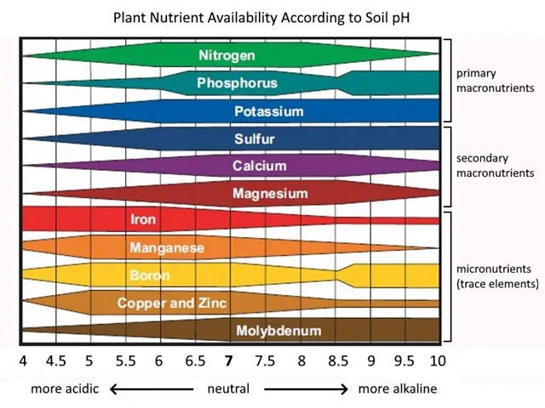

Slide 12
What can change soil pH? 1. Nutrient leaching
Largest effects on acid formation is leaching of dissolved and soluble ions below the crop root zone.
Most soluble anions:
NO₃⁻, Cl⁻, HCO₃⁻, and SO₄⁻²
Most soluble cations:
Na⁺, Ca⁺², Mg⁺², and K⁺
Leaching of cations reduce base saturation and pH

Slide 13
What can change soil pH? 2. Soil buffering capacity
The ability of the soil to resupply nutrients to solution.
As plant roots absorb K⁺, K⁺ on the CEC is desorbed to resupply solution K⁺.
P is taken up and replaced by P minerals dissolved to resupply solution H₂PO₄⁻.
Sandy soils have the lowest buffer capacity, so they can acidify faster because they don’t resist the change in pH.
For the same reason they can also be corrected the easiest.
Example: Less lime is needed to increase the pH of acidic sandy soils compared with clay soils.

Slide 14
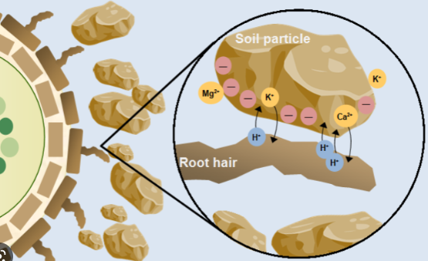
What can change soil pH? 3. Plant activity
Note: The figure below has root hairs that
blueberry does not. Uptake occurs directly
through the root surface.
Plant can alter soil pH through imbalanced cation/anion uptake
As cations are taken up by plant roots, electrical neutrality is maintained by uptake of anions or extrusion of H⁺ or an organic acid
The opposite is also true, uptake in anions result in extrusion of OH⁻ or HCO₃⁻
Excess cation uptake results in net increase in soil pH
Leaching of NO₃⁻ and SO₄⁻² along with equivalent cations decrease soil pH

Slide 15
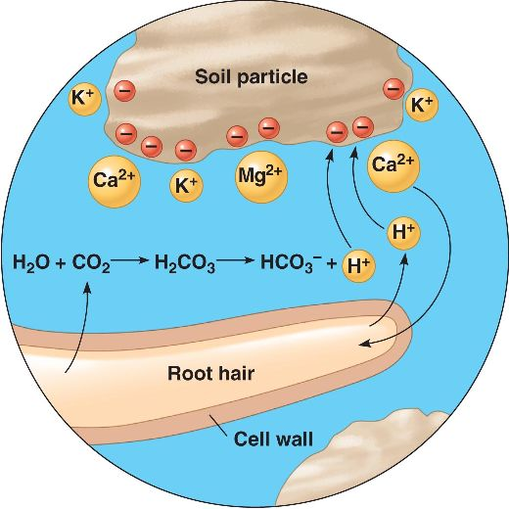
Roots acidify soil to solubilize nutrients
Plants secreting H⁺ by cellular respiration: CO₂ reacts with H₂O to form carbonic acid (H₂CO3) in the soil, which dissociates to add H⁺ to the soil.

Slide 16
What can change soil pH? 4. Fertilizers
Transformation of NH₃ or NH₄ fertilizer to NO₃ in the soil produces large amount of H⁺
Soil acidification is increased when S and P sources are combined with NH₄
The amount of H⁺ is relatively small and has little effect on bulk soil pH in the short term.

Slide 17
Soil pH affects nitrogen volatilization
Soil pH can play a role in N volatilization losses. Ammonium (NH₄⁺)in the soil solution exists in equilibrium with ammonia gas (NH₃).
The equilibrium is strongly pH dependent. The difference between NH₃ and NH₄⁺ is one H⁺ ion.
For example, if NH₄⁺ were applied to a soil at pH 7, the equilibrium condition would be 99% NH₄⁺ and 1% NH₃. At pH 8, about 10% would exist as NH₃ gas.
This means that ammonium N sources will volatilize more at higher soil pH.
Special note about urea (46-0-0): It converts to ammonium carbonate, creating its own high pH environment.

Slide 18
Soil pH affects micronutrient availability
Micronutrients important for blueberry production include iron, manganese, zinc, copper, and boron.
Example: Fe may be present in the soil in sufficient quantities but unavailable for plant uptake at higher soil pH.
Pine bark contains micronutrients such as Mn, along with lowering soil pH.

Slide 19
Summary – Know your soil pH!
Know the pH scale and what it means.
Be aware that soil pH affects chemical and biological functions, in particular plant nutrient availability.
Know (and manage) the causes of pH change in Florida sandy soils:
Nutrient leaching (pH ↓)
Low soil buffering capacity (pH ↑ or ↓)
Plant growth and residue decomposition (pH ↓)
Fertilizer choices (pH ↑ or ↓ or neutral)
Irrigation water (pH ↑)

Slide 20
Thank you

