Slide 1
FBGA Blueberry Acres Survey
Gary K. England
UF/IFAS Extension

Slide 2
FBGA Acres Survey
Purpose
  Crop insurance for all Florida Blueberry Producers
  Help in crop forecasts for marketing the crop
USDA Data?
In the fall of 2013 FBGA Board decided to work with UF/IFAS Extension Agents around the state to complete the survey

Slide 3
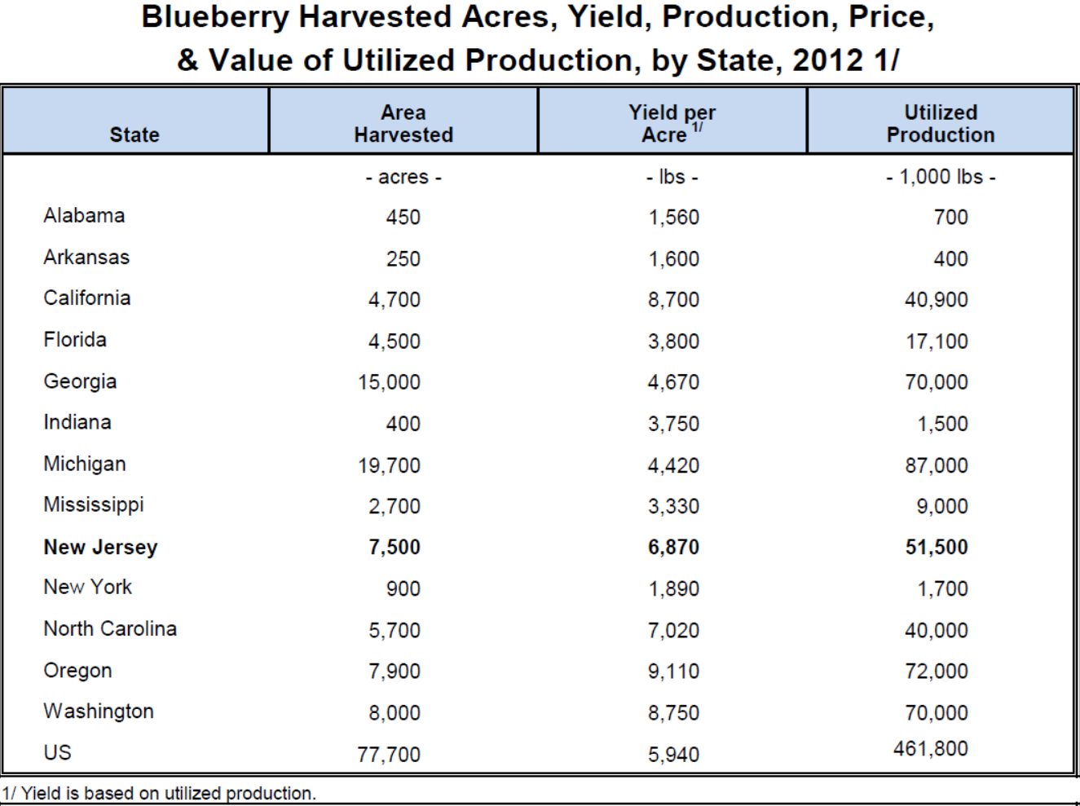
USDA Data

Slide 4
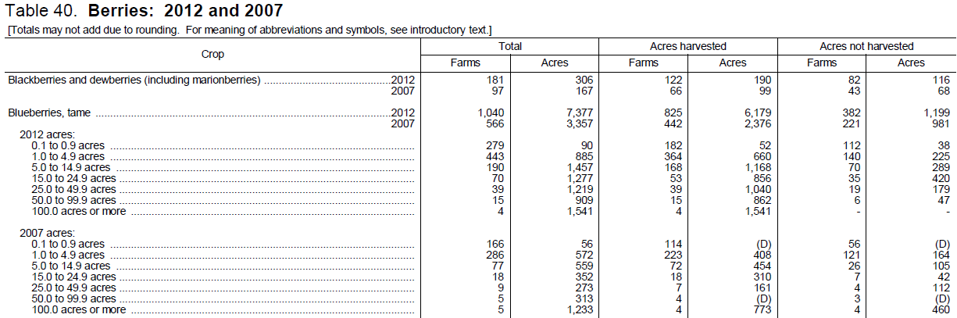
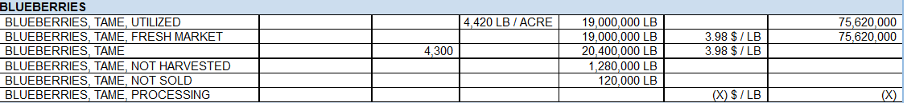
2012 Census of Agriculture
2007 = 3,357 Acres
2012 = 7,377 Acres
2012 Census of Agriculture data ends 2011
2012 Florida Agricultural Overview

Slide 5
2012 Census of Agriculture
County Level Data
Major Florida Blueberry counties per USDA/NASS 2012 Census of Agriculture (2011 Data)
County | Acres Planted | Acres Harvested
Alachua | 1,917 | 1,692
Citrus | N/A | N/A
DeSoto | 82 | 37
Hardee | 79 | 79
Hernando | 280 | 235
Highlands | N/A | 35
Hillsborough | 667 | 588
Lake | 301 | 218
Levy | 48 | 35
Marion | 597 | 513
Orange | N/A | 27
Pasco | 217 | 179
Polk | 1,412 | 1,265
Putnam | N/A | 73
Sumter | 420 | 402
Totals: | 6,020 | 5,378

Slide 6
Farm Name/Contact: | Agent Code: |  | Acres of Each Age |  |  |  | Spacing
 |  | Cultivars | <1yr | 1-2yrs | 3-7yrs | 8/older | Row | Plant
Mailing Address:
Physical Address or GPS:
E-mail:
Phone Number:
Irrigation System |  | Production System | In Ground | Pine Bark | Incorporated Pine Bark | Container | Organic | Other
Overhead |  | Check All that apply
Circle One micro-sprinkler drip |  | Visual Rating | Circle One | Good |  | Fair |  | Poor
Notes: |  |  |  |  |  | % Stand

Slide 7
Conducting the Survey
Coordinating with Extension Agents Around the state
  Call less than 10 acre
  Visit Larger than 10 acre
Extremely time consuming and have had trouble making headway
In some cases farms not very responsive

Slide 8
 |  | Cultivar/Age
 |  | Jewell |  |  |  | Emerald |  |  |  | Primadonna |  |  |  | Springhigh |  |  |  | Farthing |  |  |  | Flicker |  |  |  | Others
County | Farm# | 1 ≤ | 1-2 | 3-7 | 8+ | 1 ≤ | 1-2 | 3-7 | 8+ | 1 ≤ | 1-2 | 3-7 | 8+ | 1 ≤ | 1-2 | 3-7 | 8+ | 1 ≤ | 1-2 | 3-7 | 8+ | 1 ≤ | 1-2 | 3-7 | 8+ | 1 ≤ | 1-2 | 3-7 | 8+ | Comments
Hardee | 1 |  |  | 28 |  |  |  | 26 |  |  |  | 26 |  |  |  |  |  |  |  |  |  |  |  |  |  |  |  | 7
408 | 2 | 1 |  | 5 | 8 |  |  | 3 | 8 |  |  |  | 4 |  |  |  |  |  |  |  |  |  |  |  |  |  | 1 |  | 5
 | 3 |  |  | √ |  |  |  | √ |  |  |  | √ |  |  |  | √ |  |  |  | √ |  |  |  | √ |  | 4 others |  | 54 |  | Acres of each variety not included
 | 4 |  |  |  | √ |  |  |  | √ |  |  |  | √ |  |  |  | √ |  |  |  |  |  |  |  | √ |  |  |  | 88 | Acres of each variety not included
 | 5 |  |  | √ |  |  |  | √ |  |  |  |  |  |  |  | √ |  |  |  |  |  |  |  |  |  | 1 other |  | 50
 | 6 |  | √ |  |  |  | √ |  |  |  |  |  |  |  | √ |  |  |  |  |  |  | 5 |  |  |  | 9 | 80 |  |  | 14 acres new not sure age of others
Hernando | 1 |  |  |  | 4 |  |  |  | 4 |  |  |  |  |  |  |  |  |  |  | 1 |  |  |  |  |  |  | 1 | 1 |  | 3 0thers
144 | 2 | 4 |  | 2 | 2 |  |  | 2 | 2 |  |  | 2 |  |  |  |  |  |  | 2 |  |  |  |  |  |  |  |  | 1 | 1
 | 3 |  |  | 10 | 20 |  |  | 5 | 15 |  |  | 10 | 2 | 2 |  | 3 |  |  |  | 8 |  |  |  |  |  |  | 1 | 4
 | 4 |  |  |  | 4 |  |  |  | 4 |  |  |  |  |  |  |  |  |  | 1 |  |  |  |  |  |  |  | 1 | 5 | 4 | 6 others
 | 5 |  |  |  |  |  |  |  |  |  |  |  |  |  |  |  |  |  |  |  |  |  |  |  |  |  |  |  | 10 | Unknown age and cultivars
 | 6 |  |  |  |  |  |  |  |  |  |  |  |  |  |  |  |  |  |  |  |  |  |  |  |  |  |  |  | 3 | Unknown age and cultivars
 | 7 |  |  |  |  |  |  |  |  |  |  |  |  |  |  |  |  |  |  |  |  |  |  |  |  |  |  |  | 1 | Unknown age and cultivars
 | 8 |  |  |  |  |  |  |  |  |  |  |  |  |  |  |  |  |  |  |  |  |  |  |  |  |  |  |  | 1 | Unknown age and cultivars
 | 9 |  |  |  |  |  |  |  |  |  |  |  |  |  |  |  |  |  |  |  |  |  |  |  |  |  |  |  | 1 | Unknown age and cultivars
Orange | 1 |  | 1 | 2 |  |  | 1 | 2 |  |  | 1 | 2 |  |  | 1 | 2
127 | 2 | 5 |  |  |  |  |  |  |  |  |  |  |  |  |  |  |  |  |  |  |  |  |  |  |  | 10 |  |  |  | Meadowlark
 | 3 |  |  | 2 |  |  |  | 2 |  |  |  |  |  |  |  |  |  |  |  |  |  | 3 |  |  |  |  |  | 2 |  | 3 cultivars
 | 4 |  |  | 5 |  |  |  | 5 |  |  |  |  |  |  |  |  |  |  |  |  |  |  |  |  |  |  |  | 5 |  | Windsor
 | 5 |  |  | 5 | 5 |  |  | 5 | 5 |  |  |  | 2 |  |  | 4 | 3 |  | 1 |  |  |  | 10 |  |  |  |  |  |  | 4 others minimal acreage
 | 6 | 14 |  |  |  | 13 |  |  |  |  |  |  |  | 9
Sumter | 1 |  |  |  | 7 |  |  |  | 3 |  |  |  | 1 |  |  |  |  |  |  |  |  |  |  |  |  |  |  |  | 1
129 | 2 |  |  |  | 6 |  |  | 4 |  | 5 |  | 6 |  | 5 |  | 4 |  |  |  |  |  |  |  |  |  | 1
 | 3 |  |  | 11 |  |  |  | 15 |  |  |  | 2 |  |  |  |  |  |  |  |  |  |  |  |  |  |  |  | 2
 | 4 |  |  | 4 |  |  |  | 4 |  |  |  |  |  |  |  |  |  |  |  | 4 |  |  |  |  |  |  |  | 6
 | 5 |  |  |  |  |  |  | 1 |  |  |  | 1 |  |  |  |  |  |  |  |  |  |  |  |  |  |  |  | 1
 | 6 |  |  | 1 |  |  |  | 1 |  |  |  |  |  |  |  |  |  |  |  |  |  |  |  |  |  |  |  | 2
Hardee
408 Ac.
Hernando
144 Ac.
Orange
127 Ac.
Sumter
129 Ac.

Slide 9
Where do we go from here?
If acceptable to the FBGA, would like to explore utilizing County Property Appraiser data as a starting point
  Can at least get rough estimate of acreage and make contact from there
  Some key Counties like Lake, Hillsborough and Polk have good databases
Also encouraging growers to make contact and let us know they are interested in participating

Slide 11
Agents Helping with the Survey
Mr. Dan Fenneman
Ms. Elena Torro
Mr. Bob Hochmuth
Mr. Jim Devalerio
Dr. Aparna Gazula
Dr. Cami Esmel McAvoy
Ms. Alicia Whidden

Slide 12
Interested in participating?
Gary K. England
(352) 343-4101 Ext. 2729
gke@ufl.edu

